Slide 1


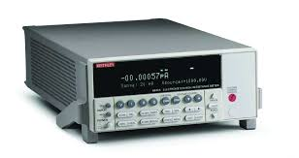

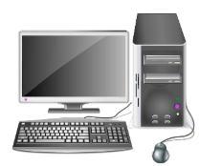

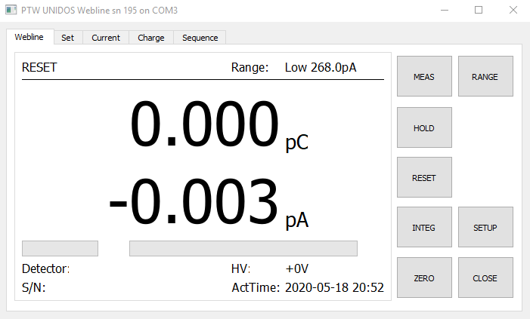
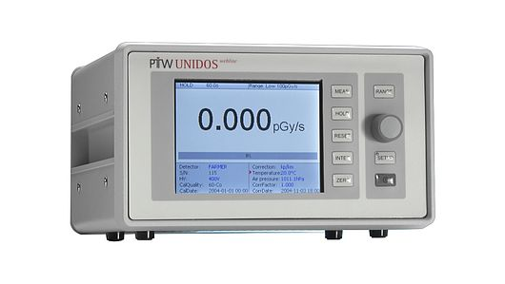
Proposed calibration workflow
Administrative data, manual entry (for now)
Calculations to produce results
Check validity of data (QA)
Request sequence of measurements?
Database
Generate reports
Laboratory
Reference instrument
PDF
DCC (xml)
Human
PC with data acquisition software
Client instrument
Measurement results
(text files)

Slide 2
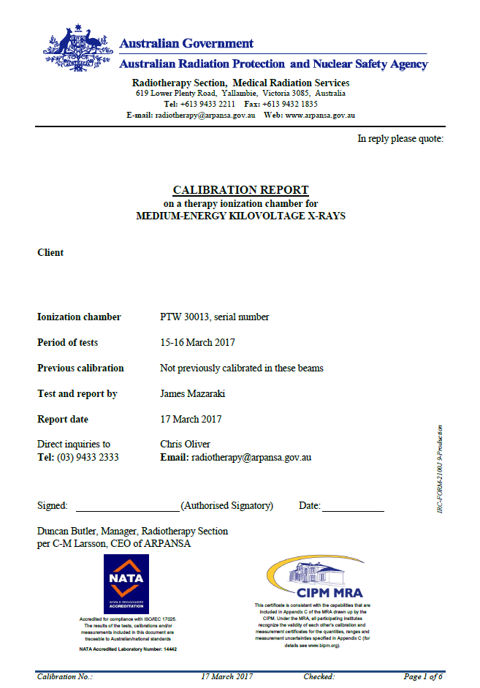



Actual workflow in PSDL
Client’s equipment
Setup for calibration
Measure
PDF
(un-signed)
2
Select files
Setup
Data files
1
Excel
Identification of equipment
Settings
Anything non-standard?
3

Slide 3
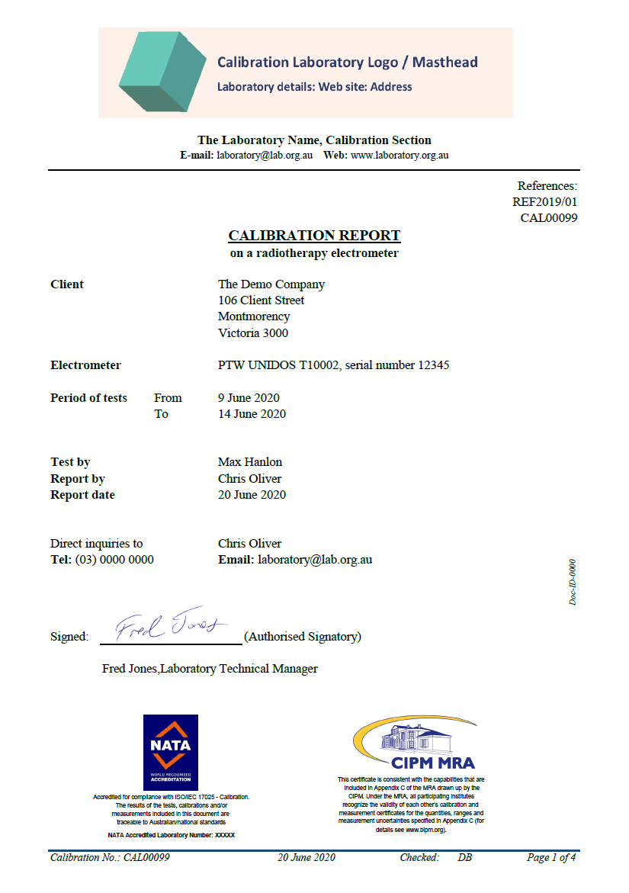
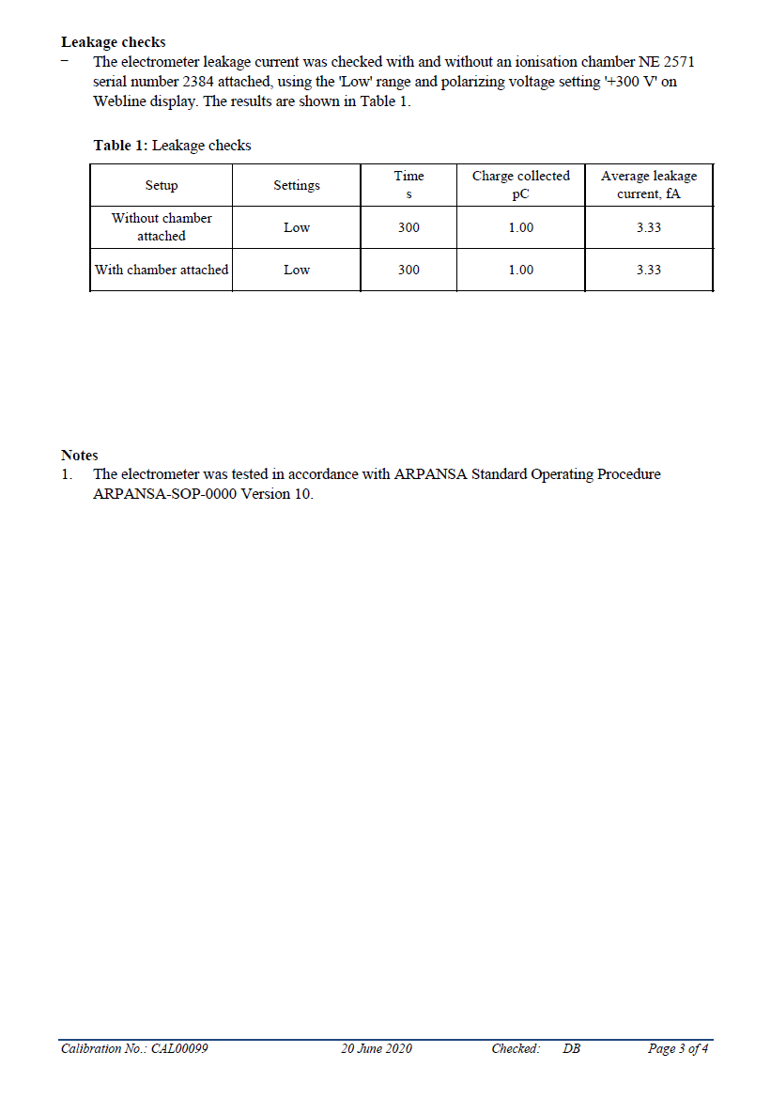
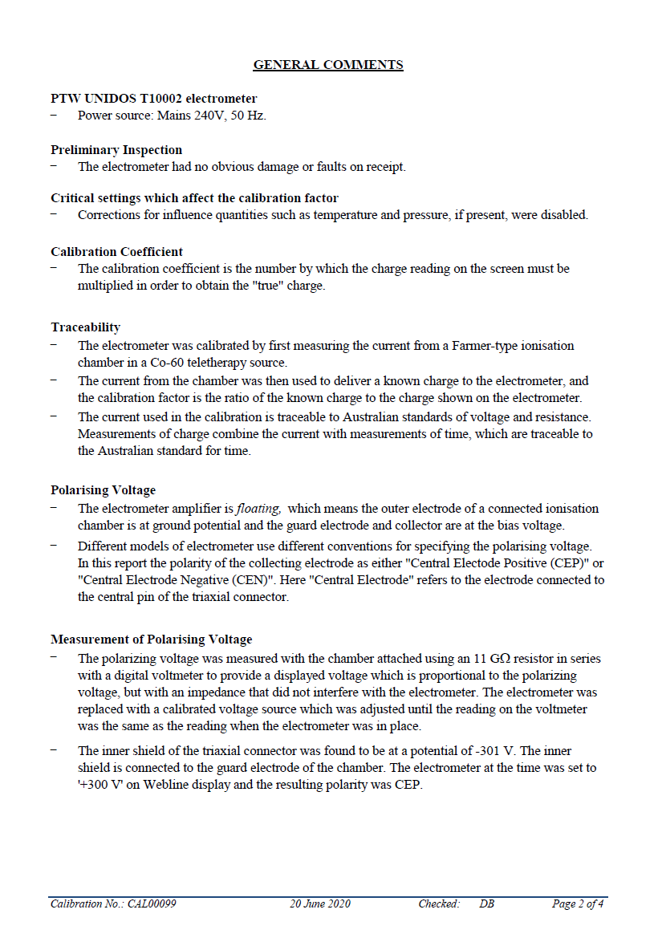
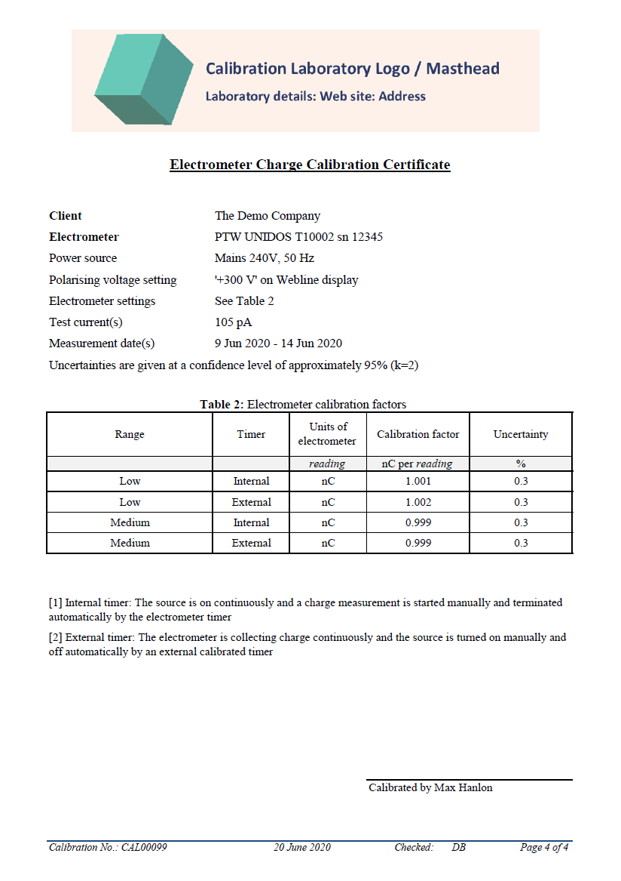
PDF of measurement report

Slide 4
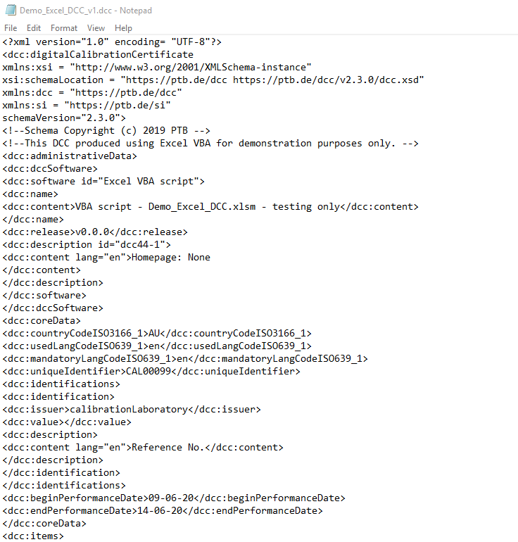
Digital Calibration Certificate (DCC)

